Slide 1

Experiential Learning Project Assessment-I on
“English Dictionary”
under the course
Python Programming Language (N-PCCCM304P)
Presented By: Divya Kolhe [CM25017]
Under the Guidance
of
Mrs. Mayuri Getme
Session:2026-27 (ODD )
Department of CSE(AI&ML)
S. B. JAIN INSTITUTE OF TECHNOLOGY MANAGEMENT AND
RESEARCH,NAGPUR
An Autonomous Institute, Affiliated to RTMNU, Nagpur
)

Slide 2
Contents
Problem Statement
Objectives
Algorithm
Flowchart / Pseudocode
Understanding of Python Logic
Graphical Representation and Working
GitHub Account, Repository & Collaboration
Individual Contribution
Result / Expected Output

Slide 3
1.Problem statement
Aim
To develop a simple English Dictionary Application using Python.
To help users quickly find the meaning of English words.
To provide pronunciation, synonyms, antonyms, and example sentences.
To help users find the correct word when they enter a misspelled
word.
To provide all important word information in one simple and user-
friendly application.
To demonstrate the use of Python dictionaries, file handling, APIs, and
basic programming concepts.
S. B. Jain Institute of Technology Management and
research

Slide 4
2.Objective
To create a Python program that works like a digital dictionary.
To make learning new English words easier and faster.
To give users useful details about a word in one place.
To help users improve their vocabulary and spelling.
To use programming concepts like functions, dictionaries, files, and
APIs.
To make the program simple, interactive, and easy to understand.

Slide 5
3. Algorithm
Start a program
.
Enter a word.
Check the word in the dictionary/API.
Get the word details.
Display meaning, pronunciation, synonyms, antonyms, and example.
If the word is wrong, show spelling suggestions.
Ask for another search.
Save required data.
Stop the program.

Slide 6
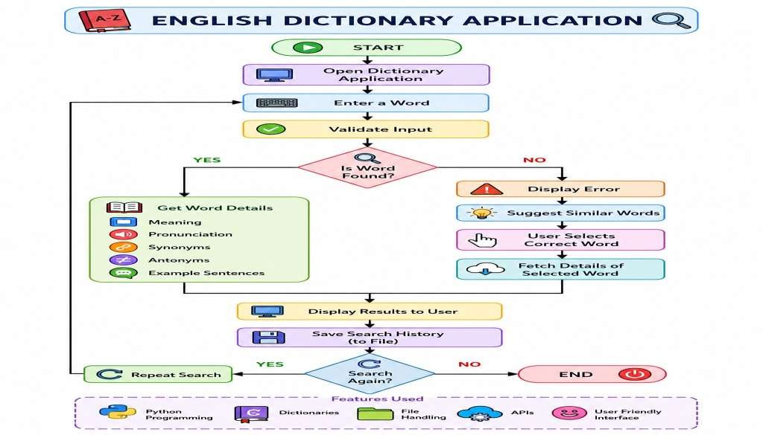
4.Flowchart

Slide 7
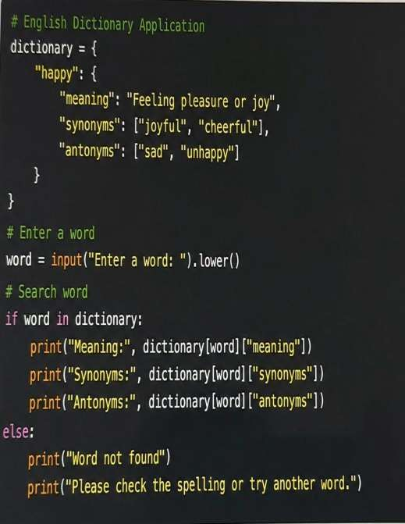
5. Understanding of python logic
Dictionary: Stores word
details.*
Input: Takes a word from the user.*
Search: Checks whether the
word exists.*
If-Else: Displays the result or
error.*
API: Gets word information.* File Handling: Saves search history.*
Loop: Allows another search.

Slide 8
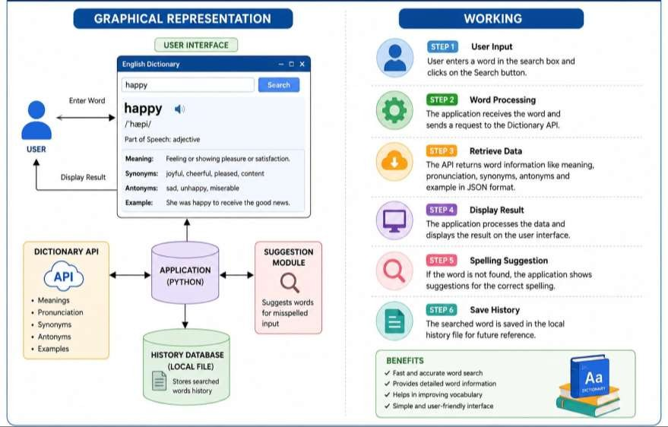
6. Graphical Representation and Working

Slide 9
7. GitHub Account, Repository & Collaboration
Create GitHub Account – Set up a personal GitHub account.
Create Repository – Create a repository for the English Dictionary
project.
Upload Code – Upload the Python project files.
Meaningful Commits – Save changes with clear commit messages.
Collaboration – Share the repository with team members and work
together.
Individual Contribution – Each member contributes and commits their
work.
Track Changes – Use GitHub to manage and track project updates.

Slide 10
8. Individual Contribution
Problem Analysis – Understood the requirements of the English
Dictionary application.
Algorithm Design – Designed the steps for word searching and
spelling suggestions.
Python Coding – Developed the dictionary functions using Python.
API Integration – Used an API to get word meanings and other details.
Testing – Tested different words and checked the application results
GitHub Contribution – Uploaded the code and made meaningful
commits.
Documentation & PPT – Prepared the project explanation, flowchart,
and presentation slides.

Slide 11
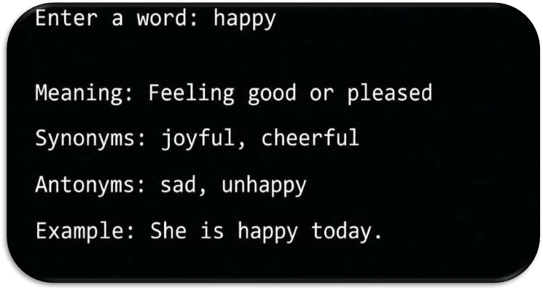
9. Result / Expected Output

Slide 12
Thank You
English dictionary application using python

